Slide 1

BEYOND GRUDGES DREAMS
and
1H
De Vera, Adrian
Farro, Frederick Anthony
Tamayo, Dynah
Valdez, Justine Gail
“ Our aim is to AIM “

Slide 2
INTRODUCTION

Slide 3
Target Users:
10 years old and above (qualified in quick movements, logic solving and the like)

Slide 4
Scope and Limitation
Level ranking capability
Every designated places generate questions to reach the next level.
Includes guide for the beginners
Prohibited to 9 and below

Slide 5
Existing
Yes but different in style and concept.

Slide 6
Proposal
Chibi monsters will be the enemies
Specific problems
Situation analysis

Slide 7
Usability kit
Photoshop
Game Editor

Slide 8
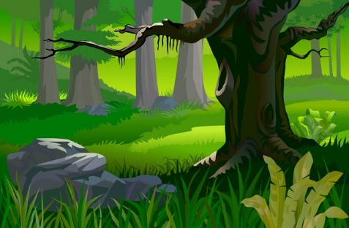

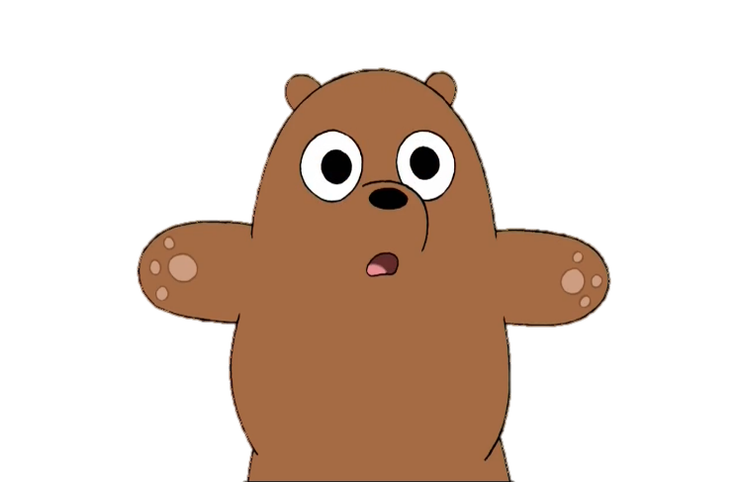
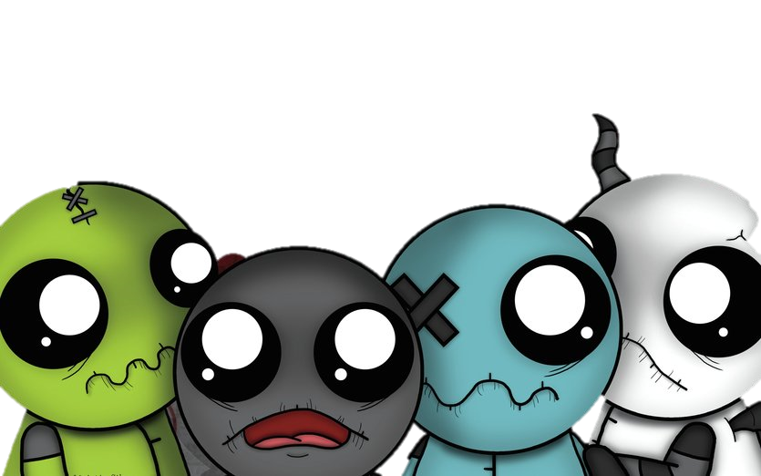
PLAY
ABOUT
OPTION
HELP
Exit

